Slide 1
Project Specialist Training Manual
Notes:
This is an example of a Title Slide. We need to convey Life Is On in everything we do, so try to lead with compelling images that are vibrant, authentic, and human. The human element should be apparent and within the context of a segment that we touch.
To keep this PowerPoint template file size reduced, we included a small library of image choices in the Slide Master (under View). You can also get them from the SE Asset Library: https://schneiderelectric.telescopeondemand.com

Slide 2
PCR
MOVE
MOVE DASHBOARD
GPS
WORKSHOP TOOL
LINK TO STRATEGIC PORTAL
PRISM
FUNDAMENTAL TRAININGS
Notes:
Agenda slide

Slide 3
PCR
Sonia Arzola
Notes:
This is an example of a Title Slide. We need to convey Life Is On in everything we do, so try to lead with compelling images that are vibrant, authentic, and human. The human element should be apparent and within the context of a segment that we touch.
To keep this PowerPoint template file size reduced, we included a small library of image choices in the Slide Master (under View). You can also get them from the SE Asset Library: https://schneiderelectric.telescopeondemand.com

Slide 4
PCR
The Product Evolution Process Request Content & Impact Analysis Form (IAF) is a form used to describe a project idea.
It is used to evaluate the financial viability and impacts of an evolution request. This document should be an attachment to the TEMPO request.
This is a LIVING DOCUMENT to be updated throughout the life of the project. This document should be reviewed and approved at the Open stage gate or prior.
The document can be reviewed at any stage gate deemed necessary by the Board of Change (BOC).
Notes:
This is an example of a Text Slide. Reference the different layout options in the Slide Master (under the View tab) for different variations. Remember, our new Brand Guidelines call for clean and simple messages and design. Reference the PowerPoint Guidelines on the Brand Book for tips and useful information on creating effective presentations.

Slide 5
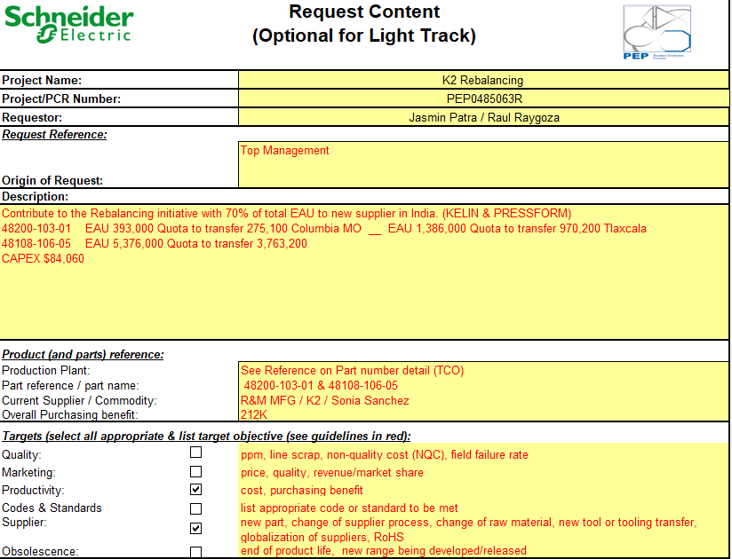
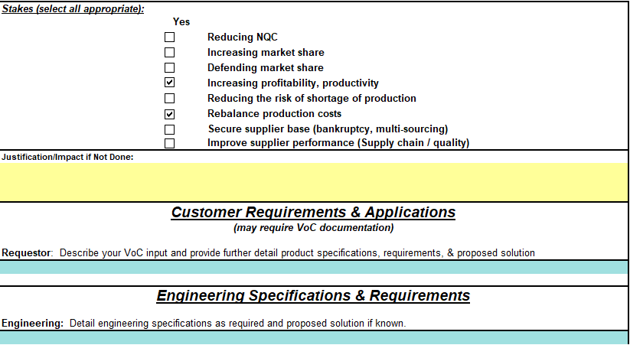
Request Content
The document will provide enough information to identify the origin of the request, product (& parts) reference, target and stakes of the project & Voice of Customer inputs.
Fill in appropriate fields to identify the origin of the request, product (and parts) reference, target and stakes of the project.
Fill in the text boxes as required to detail the Marketing and Engineering specifications for the product if needed.

Slide 6
1. Should be max.70 characters long
2. Once uploaded into Tempo
3. Dependent on where idea was generated. I.E. local initiative, QVE Workshop, Supplier, etc.
4. Summarized detailed description of project
5. If part number list is extensive, you can set it to be looked at on TCO tab
6. Marketing Input
7. Engineering Input

Slide 7
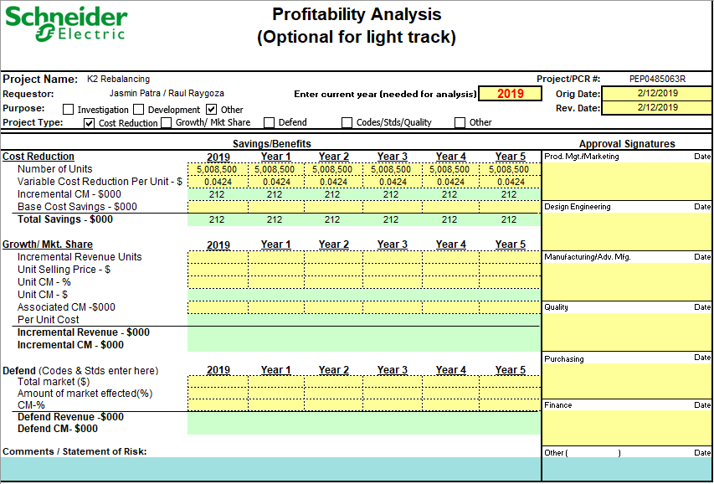
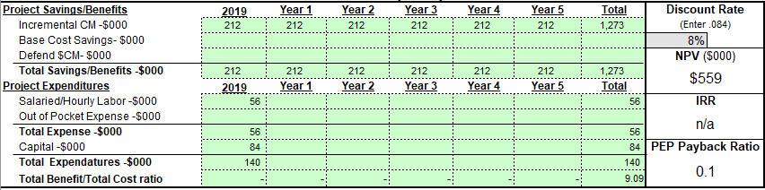
Profitability Analysis
Input savings for cost reduction requests or benefits for revenue/market share projects.
Top third of Savings-Benefits page to be completed by PROJECT REQUESTOR (with help from other functions as required) PRIOR.
TO obtaining functional input. Complete ONLY the applicable colored fields; the other non-colored fields will be calculated automatically.

Slide 8
1. Fill out all necessary information
2. Data pulled directly from TCO tab
5. Total Expenditures data pulled directly from Project Cost Estimates Tab
3. Net Present Value (NPV)
4. Internal Rate of Return

Slide 9
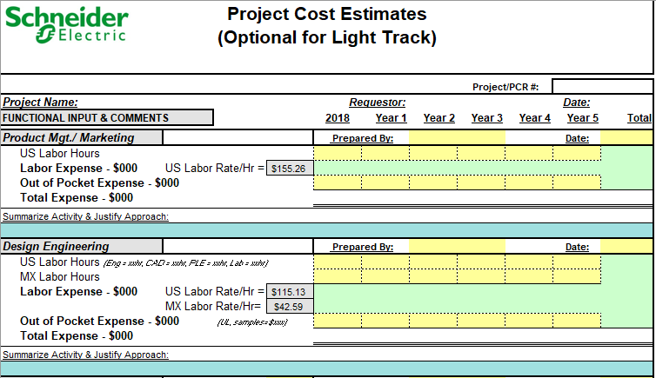
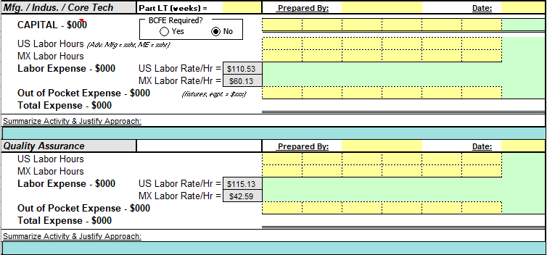
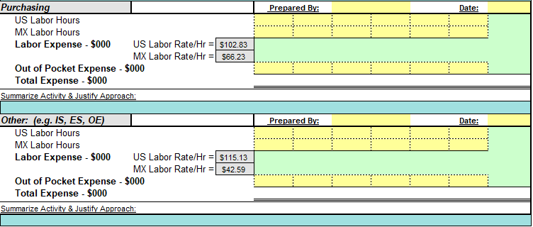
Project Cost Estimates
Cost Estimates should be entered by stakeholder from each field: Marketing, Design Engineering, Manufacturing/Industrialization/Core Tech, Quality, Purchasing and Others.
Depending on line of business, this part could be blitzed, costed separately, or costed after project is opened.

Slide 10
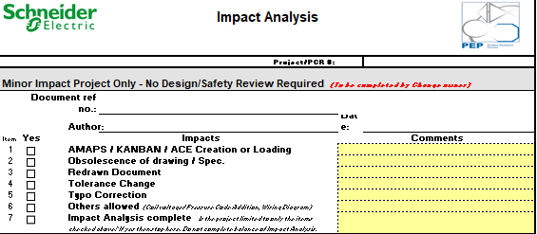
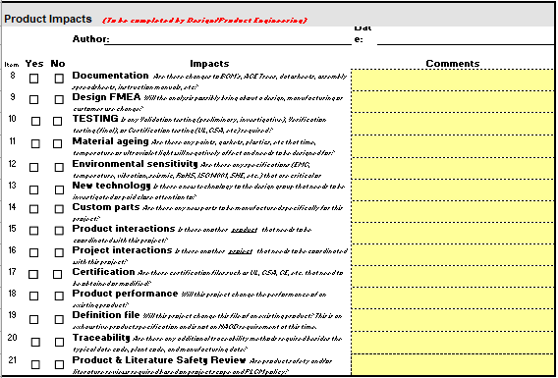
Impact Analysis
The fields to be completed are indicated by "yes" or "no" boxes.
Each functional representative is to enter appropriate comments regarding the impact to their function to execute the request. Below each function is a section of items to consider when assessing impact.
If the project is limited to items contained in questions 1-7 of the Impact Analysis, then the project has only minor impact. The remainder of the impact is unnecessary.
The preliminary impact analysis is performed prior to OPEN to determine activities to be performed by various functions and aid in the cost estimation process.
The impact analysis updates can be re-evaluated at DO stage gate. It is only required if there are changes to the document.

Slide 11
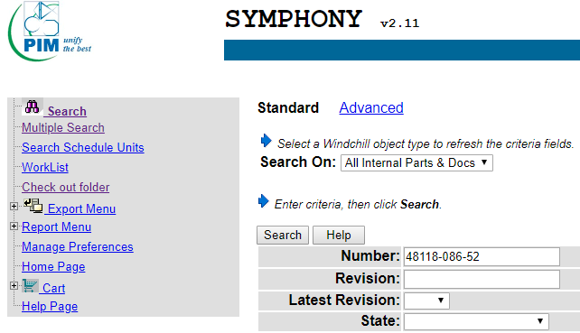
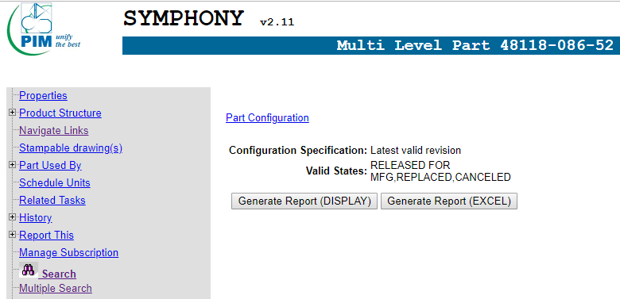
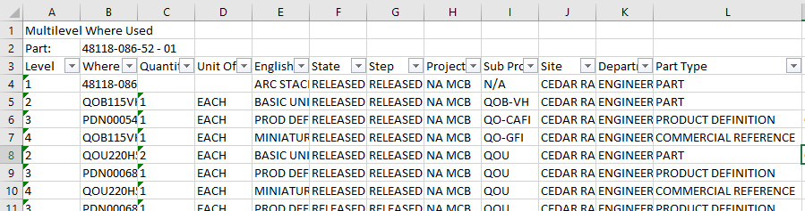
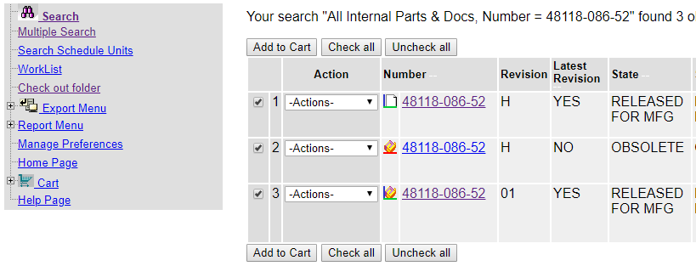
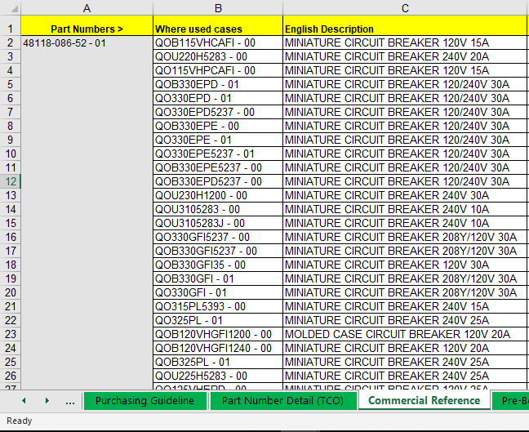
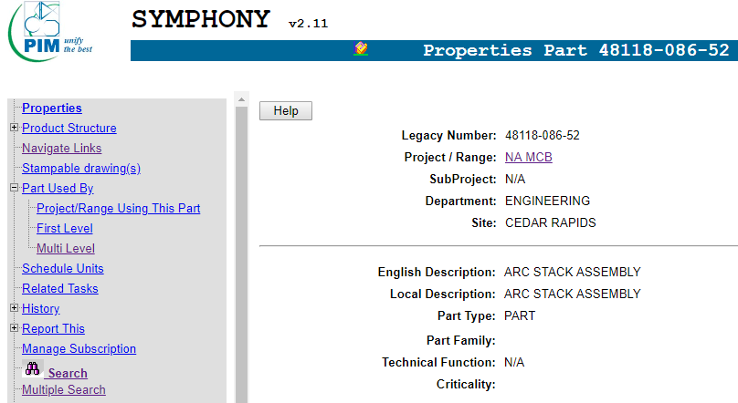
Commercial References (How to)
6. Click Generate Report (Excel) to download part list.
7. Open part structure report generated
1. Access Symphony portal and search for part number.
8. In Excel report, Part type column shows which part numbers are commercial references
9. Filter out all commercial references and paste them in PCR
2. Access latest revision and released part number
10. Paste where used cases and English description in Commercial Reference tab.
3. Go to Parts used by on left column on Properties section.
4. Click plus sign to reveal drop down list
5. Click Multilevel

Slide 12
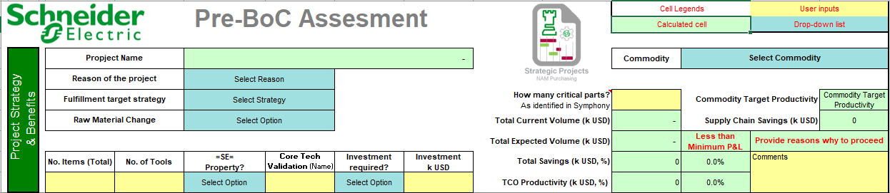
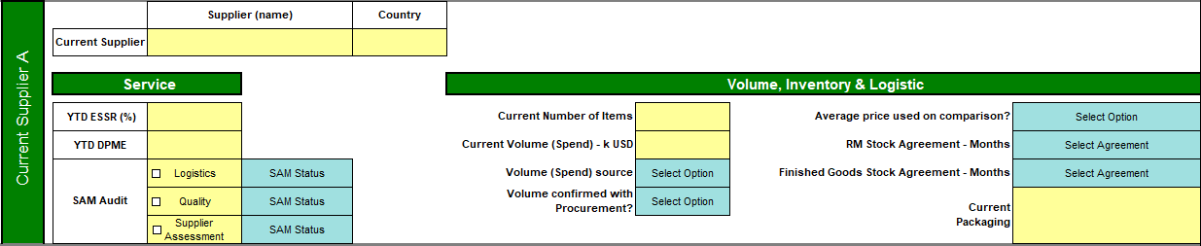
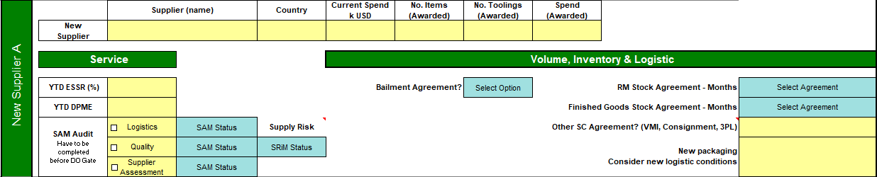
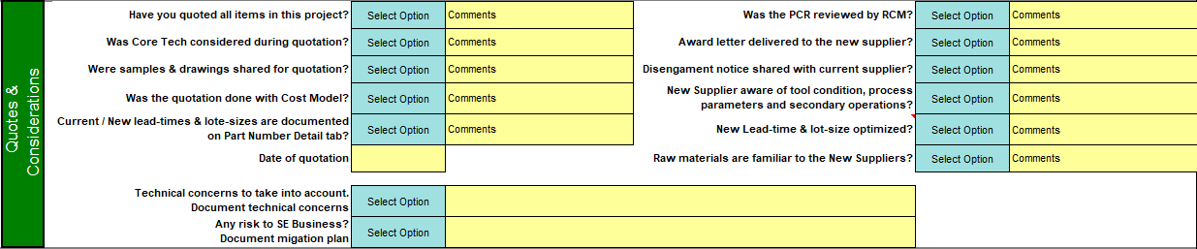
Pre-BoC Assessment
Fill out all yellow and blue fields.
Supplier information can be gathered from: SRiM, SAM Portal, RCM, Buyers and ERPs.
Quotes and considerations to be manually selected.
https://spiceportal.se.com/web/pms-purchasing-management-system1/tools

Slide 13
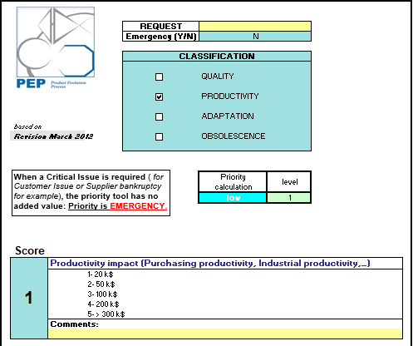
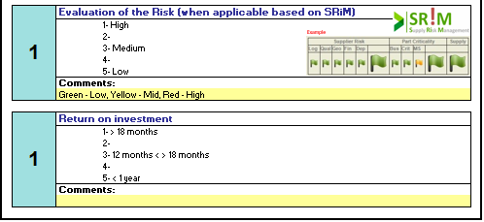
PEP Priority
Priority calculation used in TEMPO Upload.
To calculate priority, scores should be manually changed to automatically calculate field.

Slide 14
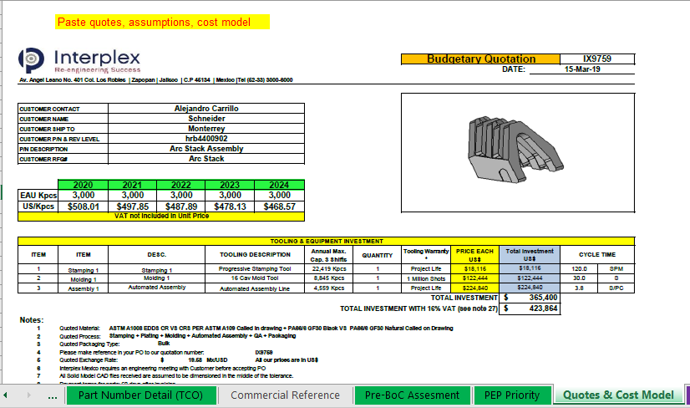
Quotes & Cost Model
General area where to paste everything from quotes, emails, cost models, etc. to back up the information.
For QVEs, proposed design vs actual design, current properties vs new properties and other additional information should be included.
If any assumptions were made, they should be explained in detail for further revision.

Slide 15
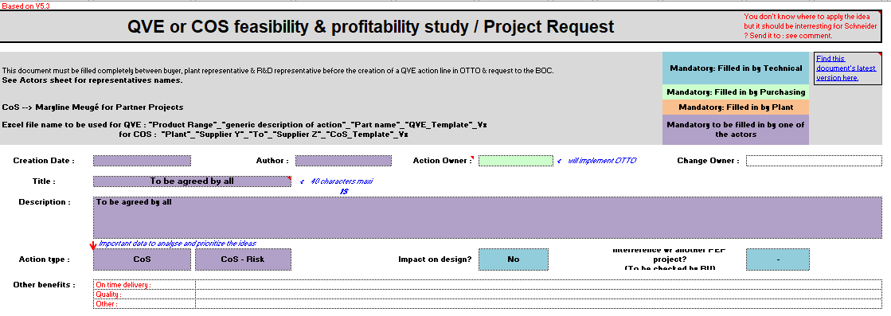
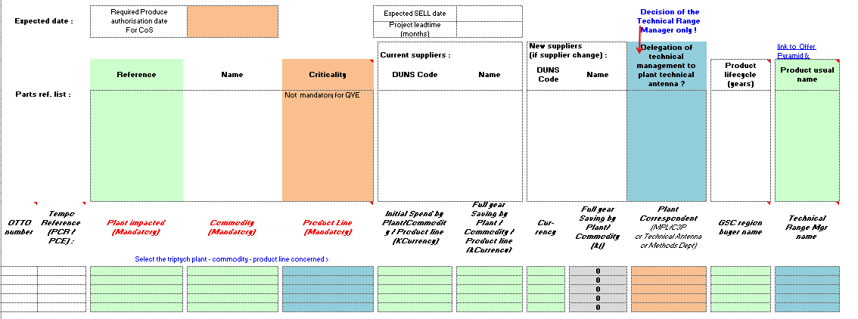
1. Revise who need to fill our information to make sure all information is correctly uploaded
2. Important information to be filled out thoroughly for presentation.

Slide 16
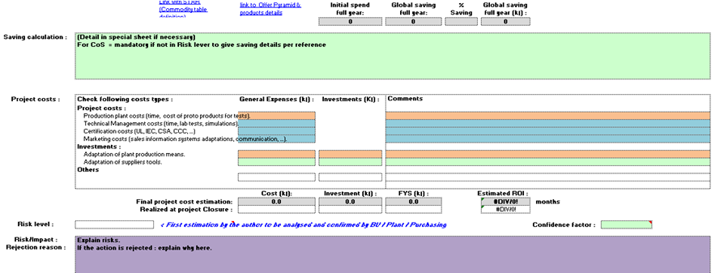
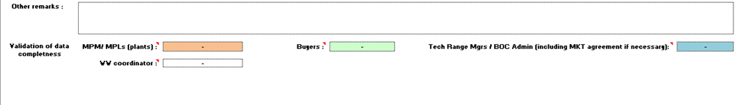
3. Project costs to be filled out by right stakeholder.
4. Other remarks can be filled out

Slide 17
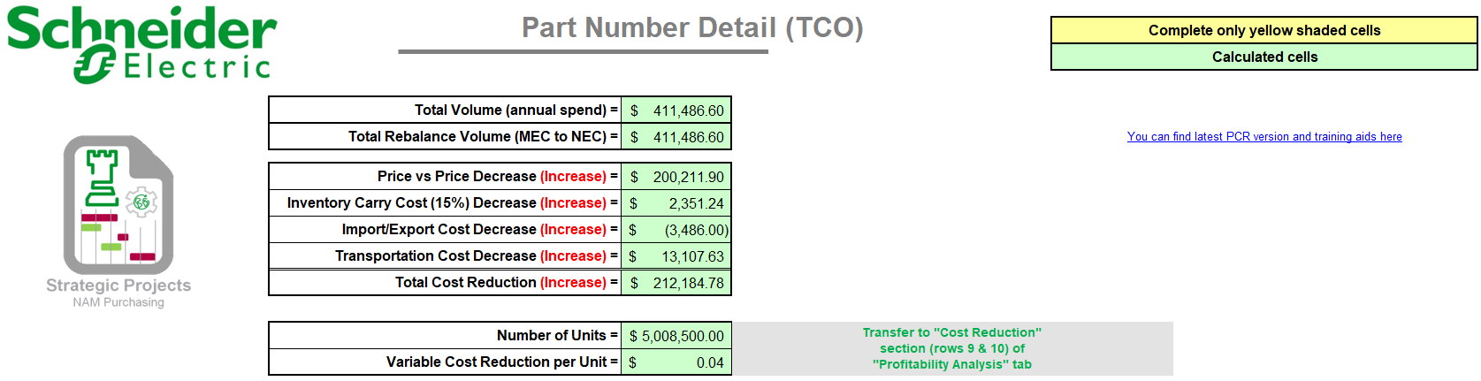
Part Number Detail
In this tab it’s filled the description of every part number and it’s reflected the impact that is pretended to have.
The Purchasing group is responsible for completing all fields in the worksheet.
Fill in the part number and correct "Product Line (MPG) or Product Family" for each individual part number. The Product Line (MPG)/Family listing is where the particular P/N(s) are ultimately used (i.e. LC, SS, MCB, CSED, Busway, NEMA, MV SWG, LV SWG, etc.)
This insures that the correct Engineering/BOC organization responsible for the design receives the PR. (Plant locations may not necessarily be at the same location as the product responsible BOC) "Plant(s)" reflect the manufacturing facility using the part.

Slide 18
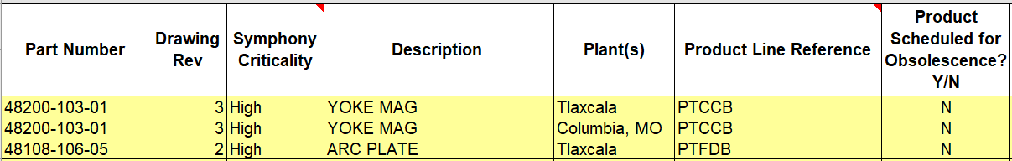
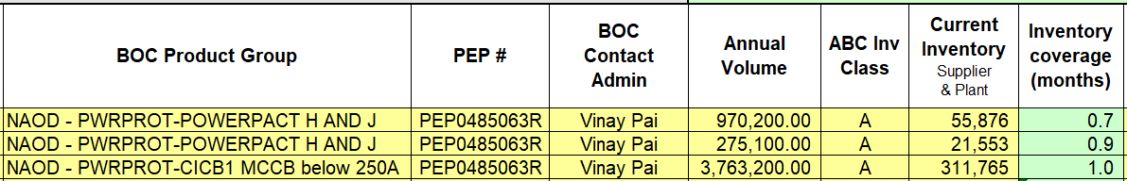
Part Number Detail
2. Prism / ERP System
3. Strategic Projects / Symphony / Plant
1.Symphony
4. Engineering / Marketing
7. Plant
5. Strategic Projects / Symphony / Plant
7. View BOC contact list
10. SAP / ERP System
6. Once uploaded to Tempo
8. SAP / Prism / MPL
9. SAP / ERP System

Slide 19
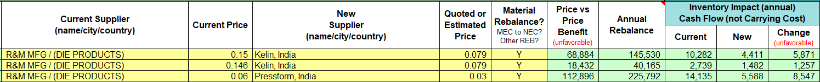
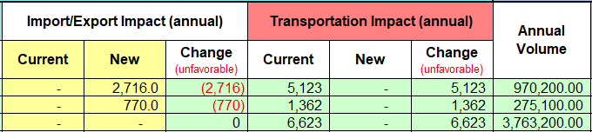
Part Number Detail
11. Prism / MPL
12. SAP / Prism / MPT Review file
13. Automatic Calculations
14. Sergio Acosta / Javier Mejia
15. Automatic Calculations

Slide 20
Part Number Detail
16. ERP System / MPL
18. Agreed with new supplier
17. MPL
21. RFQ / Timothy Kent
20. Timothy Kent
19. SAP / MPL

Slide 21
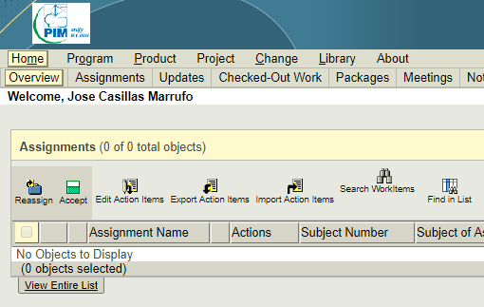
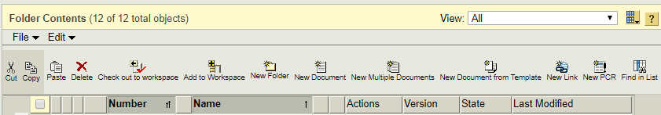
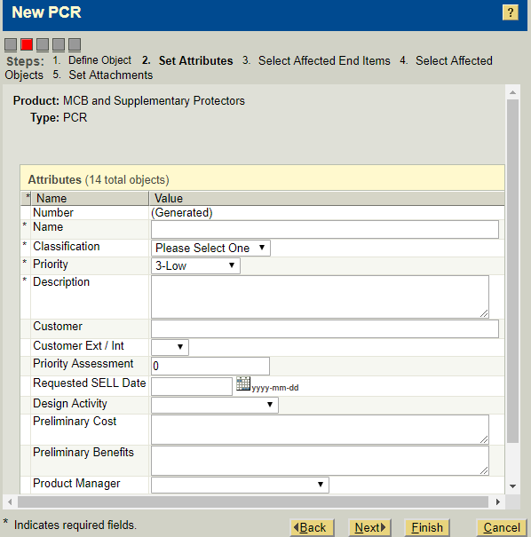
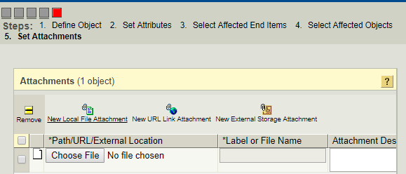
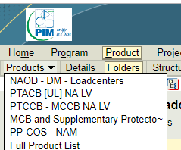
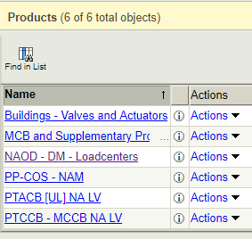
Tempo Upload (How to)
1. Access Tempo portal. Go to Product tab
5. Look for the New PCR button inside the folder content tab and click it.
2. Once inside, click on the Products drop-down menu and go to full product list.
6. Fill out all necessary information for submittal
7. Attach Excel file with complete PCR.
8. Click finish for final submittal.
3. Look for folder with the product range involved in part numbers in PCR.
4. Click on product folder to upload PCR.
Note: If folder not in your list, you must ask for access directly to BOC Admin.

Slide 22
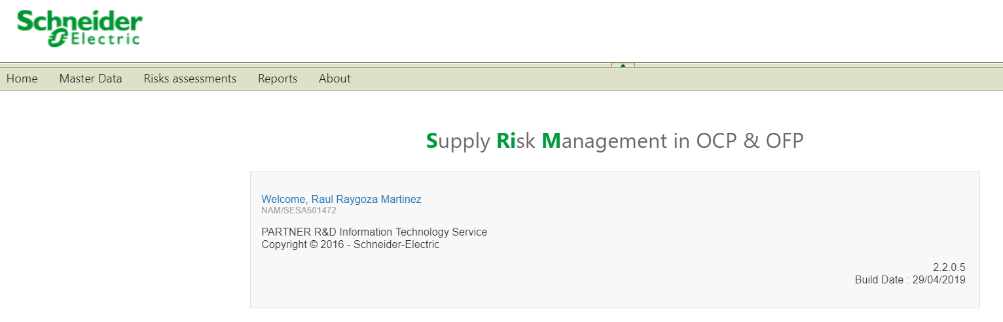
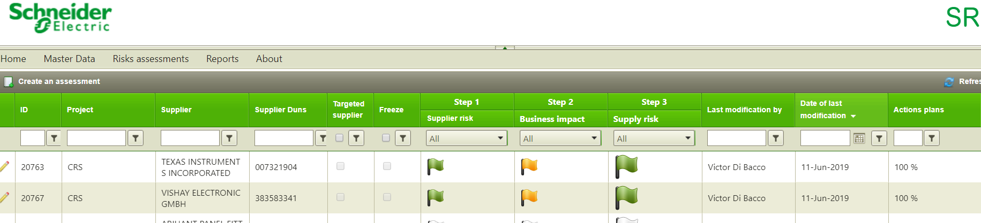
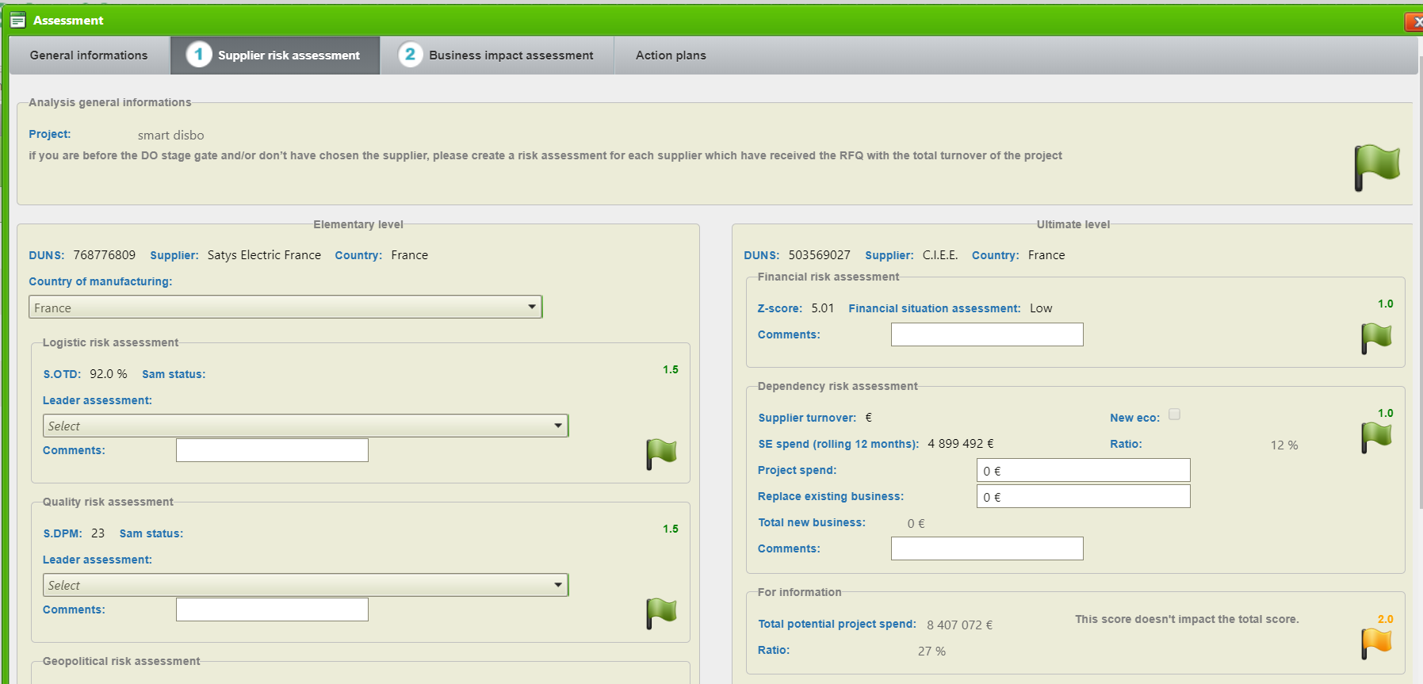
SRiM (How to)
1. Access SRiM portal and go to Risk Assessment.
2. Search by supplier or Duns.
3. Click on the flags for a more detailed view of the supplier.
4. Elementary and Ultimate duns level detailed.
5.Action plans if supplier is not on green status details.

Slide 23
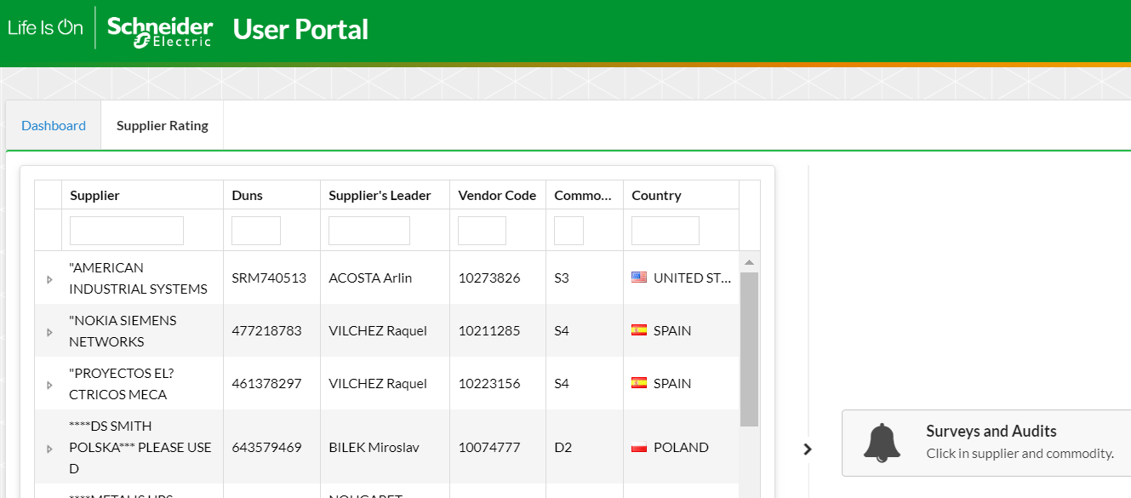
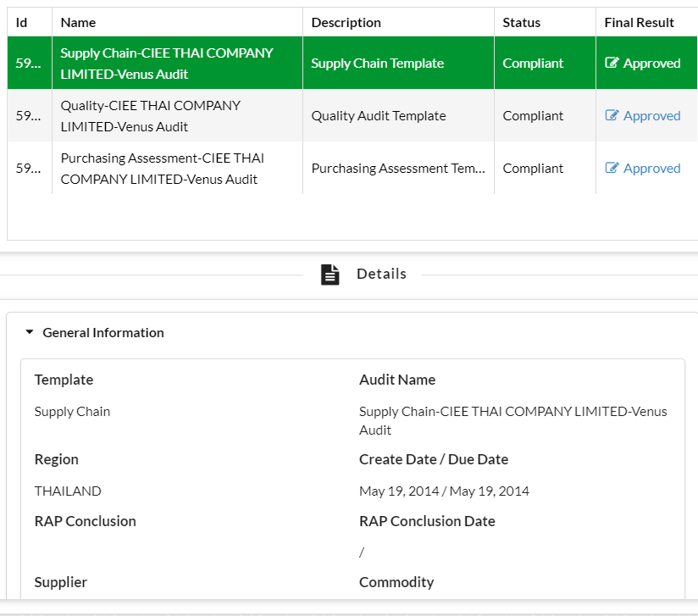
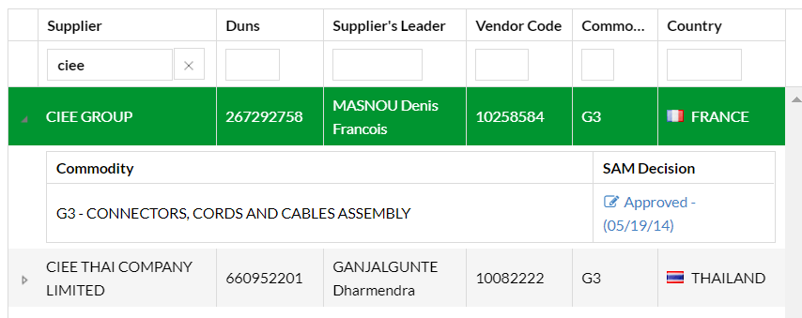
SAM Audit (How to)
1.Access SAM APPS user portal.
2.Search by supplier or duns code.
3. Select one and it will display the audit results.
4. Click on the audit status to display more details.

Slide 24
SAP Transactions
Shortcut | Description | Notes
XK03 | Look for supplier's information
ME1L | Look for all part # that the supplier has ever sold
ME2M | Produces report that displays purchase orders by material
MM60 | Materials List
MD04 | Material ledger/Stock/Requirement List
MM03 | Displays a material master record (Weight)
MMBE | Look for stock of 1 PN | SLoc -"2121" - Starting with 2, it's on production line Sloc- "4150 / 4100 / 4000" - Starting with 4, it's the real stock
MB52 | Look for multiple PN stock | SLoc -"2121" - Starting with 2, it's on production line Sloc- "4150 / 4100 / 4000" - Starting with 4, it's the real stock
ME0M | Look for the active material number out of a batch
MCBE | Annual Usage
CS12 | BOM
CS15 | BOM hacia arriba
SQ00 | Report for blocked PN, ABC, Inhouse or bought
Notes:
This is an example of a Text Slide. Reference the different layout options in the Slide Master (under the View tab) for different variations. Remember, our new Brand Guidelines call for clean and simple messages and design. Reference the PowerPoint Guidelines on the Brand Book for tips and useful information on creating effective presentations.

Slide 25
Contact Information
Transportation Cost:
Timothy Kent
Import/Export Impacts:
Sergio Acosta, Javier Mejia
Engineering Contact:
Manuel Solis
Quality Contact
Ricardo Gongora
Note: Contact information is solely for reference. Different actors may be involved in different projects

Slide 26
PCR
Box tool training
https://schneider-electric.box.com/s/rm3r0ooskdd7217j51aff8u607j4vwbl
Notes:
This is an example of a Text Slide. Reference the different layout options in the Slide Master (under the View tab) for different variations. Remember, our new Brand Guidelines call for clean and simple messages and design. Reference the PowerPoint Guidelines on the Brand Book for tips and useful information on creating effective presentations.

Slide 27
MOVE
Sonia Arzola
Notes:
This is an example of a Title Slide. We need to convey Life Is On in everything we do, so try to lead with compelling images that are vibrant, authentic, and human. The human element should be apparent and within the context of a segment that we touch.
To keep this PowerPoint template file size reduced, we included a small library of image choices in the Slide Master (under View). You can also get them from the SE Asset Library: https://schneiderelectric.telescopeondemand.com

Slide 28
MOVE TOOL
Link to MOVE Tool
https://schneider-electric.app.box.com/s/lnp4gvsg533ssww4ajqd7rn34hxcpjsz
Notes:
This is an example of a Text Slide. Reference the different layout options in the Slide Master (under the View tab) for different variations. Remember, our new Brand Guidelines call for clean and simple messages and design. Reference the PowerPoint Guidelines on the Brand Book for tips and useful information on creating effective presentations.

Slide 29
MOVE TOOL
My learning link courses
MOVE: Introduction to MOVE
Course code: GSCPURD000101
MOVE: Approving Lines in MOVE
Course Code: GSCPURD0001014
MOVE: Mass Upload in MOVE
Course Code:GSCPURD0001012
Notes:
This is an example of a Text Slide. Reference the different layout options in the Slide Master (under the View tab) for different variations. Remember, our new Brand Guidelines call for clean and simple messages and design. Reference the PowerPoint Guidelines on the Brand Book for tips and useful information on creating effective presentations.

Slide 30
MOVE DASHBOARD
Sonia Arzola
Notes:
This is an example of a Title Slide. We need to convey Life Is On in everything we do, so try to lead with compelling images that are vibrant, authentic, and human. The human element should be apparent and within the context of a segment that we touch.
To keep this PowerPoint template file size reduced, we included a small library of image choices in the Slide Master (under View). You can also get them from the SE Asset Library: https://schneiderelectric.telescopeondemand.com

Slide 31
MOVE DASHBOARD
1.-Go to the next link http://10.166.11.230/SPPL/welcome.aspx
2.- Select the MOVE dashboard
3.- The MOVE dashboard is a tool to see a summary of the information contained in one idea
Notes:
This is an example of a Text Slide. Reference the different layout options in the Slide Master (under the View tab) for different variations. Remember, our new Brand Guidelines call for clean and simple messages and design. Reference the PowerPoint Guidelines on the Brand Book for tips and useful information on creating effective presentations.

Slide 32
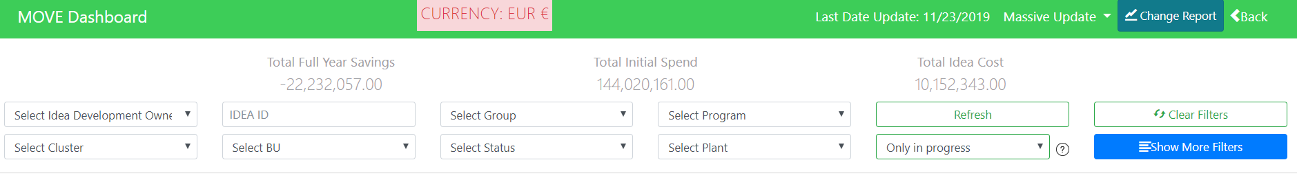
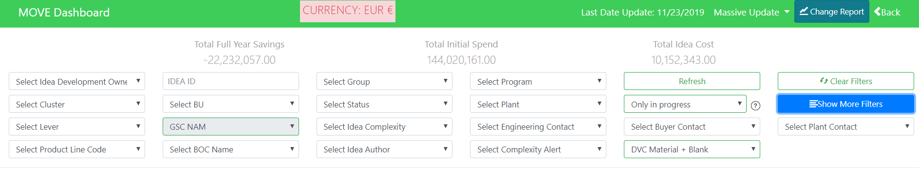
MOVE DASHBOARD
1.- You need to select the filters you need , between the options.
2.- In show more filters, you will find more options
Notes:
This is an example of a Text Slide. Reference the different layout options in the Slide Master (under the View tab) for different variations. Remember, our new Brand Guidelines call for clean and simple messages and design. Reference the PowerPoint Guidelines on the Brand Book for tips and useful information on creating effective presentations.

Slide 33
MOVE DASHBOARD
1.- You need to select the filters you need , between the options.
2.- In show more filters, you will find more options
Notes:
This is an example of a Text Slide. Reference the different layout options in the Slide Master (under the View tab) for different variations. Remember, our new Brand Guidelines call for clean and simple messages and design. Reference the PowerPoint Guidelines on the Brand Book for tips and useful information on creating effective presentations.

Slide 34
MOVE DASHBOARD
Notes:
This is an example of a Text Slide. Reference the different layout options in the Slide Master (under the View tab) for different variations. Remember, our new Brand Guidelines call for clean and simple messages and design. Reference the PowerPoint Guidelines on the Brand Book for tips and useful information on creating effective presentations.

Slide 35
MOVE DASHBOARD
Notes:
This is an example of a Text Slide. Reference the different layout options in the Slide Master (under the View tab) for different variations. Remember, our new Brand Guidelines call for clean and simple messages and design. Reference the PowerPoint Guidelines on the Brand Book for tips and useful information on creating effective presentations.

Slide 36
GPS
Sonia Arzola
Notes:
This is an example of a Title Slide. We need to convey Life Is On in everything we do, so try to lead with compelling images that are vibrant, authentic, and human. The human element should be apparent and within the context of a segment that we touch.
To keep this PowerPoint template file size reduced, we included a small library of image choices in the Slide Master (under View). You can also get them from the SE Asset Library: https://schneiderelectric.telescopeondemand.com

Slide 37


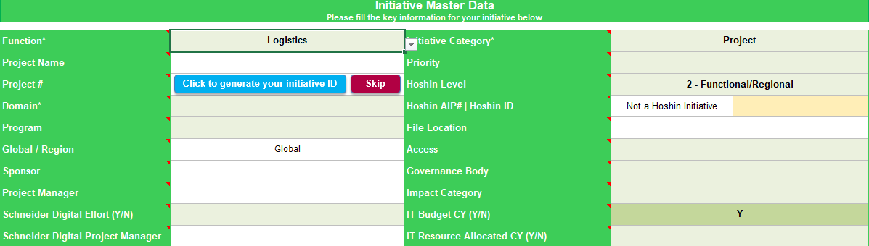
3.1 Mandatory Templates: Charter
Do not name a project using these symbols
\ / : * ? < > |
A
Mandatory fields
A
B
C
As a suggestion, in the impact category, just put the most important/relevant customer impact.
D
If you start a new initiative, you can auto-generate the number of your initiative. You can click Skip, if you already know the number, if you want to create a draft file or if you want to add it manually later. This functionality communicates with the Database.
Choose your Domain group
Select the type of restriction to information: Public or Restricted. - Public access means that everyone that have access in the Box folder "Global SCLD Projects and Programs" can view your project information. - Restricted projects with confidential information, will have their data in a separate Master list (List of Project Data) which will be visible only by a specific group of people in Box. By default, every project has a public access.
Select “Y” only if you have Schneider Digital Requirements. Depending on the project/program you will need Schneider Digital effort (e.g. SAP change, EDI, new software, etc) or IT budget and/or resources or you won’t need them.
A
Q: My project doesn’t have a project number, can I assign this number? A: For Global project, please contact Global PMO. If it’s regional project, contact regional PMO.
B
?
C
D

Slide 38
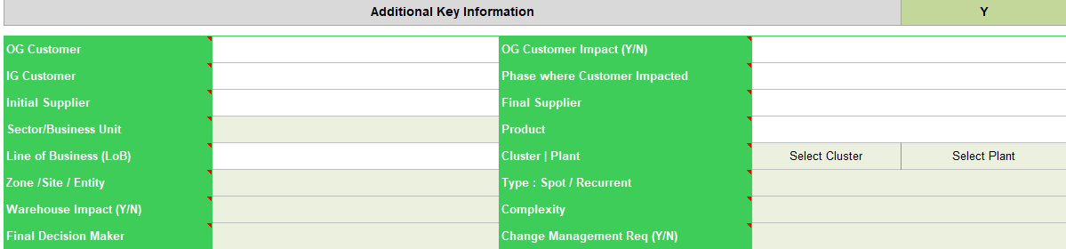
3.1 Mandatory Templates: Charter
Mandatory fields
How to populate the Hoshin
E
You can select the Hoshin level (( 1 - GSC, 2- Functional/Regional, 3- Cluster or 4- Plant)
Select the Hoshin AIP# (If your initiative doesn’t contribute to Hoshin, please leave it as it is)
Select your function
Add the name of the Cluster and/or the name of the Plant (if it is applicable)
G
E
F
F
G
Optional fields
As it is optional, you may hide these fields by selecting “N”
H
I
J
The specific outside group (OG) customer or group of OG customers impacted by the project.
Specific inside group (IG) customer or group of IG customers impacted by the project.
I
H
J

Slide 39
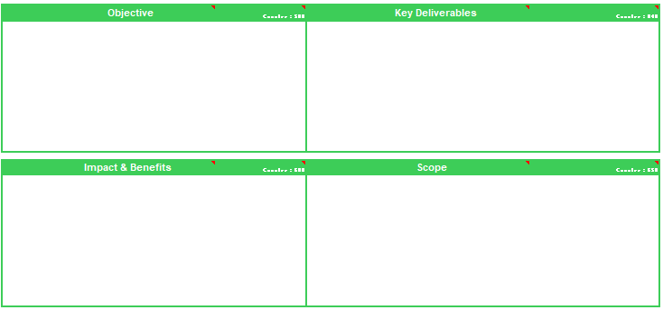
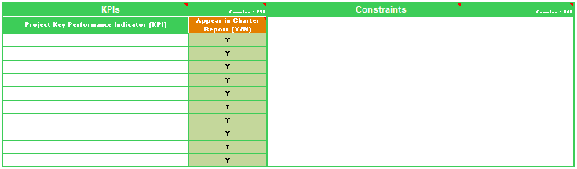
3.1 Mandatory Templates: Charter
Key deliverables are “what is left at the end of the project”.
Example: animation of the project and assessment are not deliverables.
What is the reason of the initiative?
Something toward which work is to be directed, a strategic position to be attained, a purpose to be achieved, a result to be obtained, a product to be produced, or service to be performed.
Any measurable, tangible, verifiable outcome, result, or item that must be produced to complete a project or part of a
project/program (phase).
In the Key Deliverables field, the user can display the due date of those deliverables in PowerPoint.
In order to do that, please add a semicolon “;” after the deliverable and then enter the due date.
Format
Deliverable ; Due Date e.g. Deliverable 1 ; Sep 2019
The objective must carry the organization from a troubled past to a future with benefits and value creation.
You can use the SMART methodology to define objectives for your project.
What will be the outcome, result or item that must be produced to complete the project?
The work that needs to be accomplished to deliver a product, service, or result with the specified features and functions.
The perimeter of the project: what
is related with it and what is out of
the project.
The key financial, service and other benefits of the project.
Defining what is NOT in the scope really helps defining the scope.
Key Performance Indicators to measure the success of the project.
An applicable restriction or limitation, either internal or external to the project that will affect the performance of the project or a process.
How you will measure the performance of the project?
What are the restrictions that will be affect the performance of the project?
e.g. Scope, schedule, cost, quality, etc

Slide 40
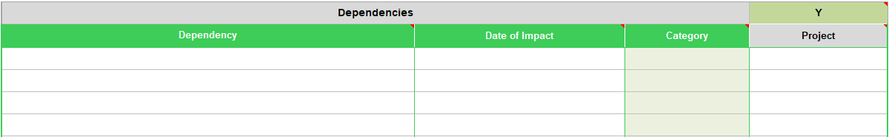
3.1 Mandatory Templates: Charter
Dependencies
A
B
C
D
Is there any relationship with any other activity/project or milestone that will impact the project?
A
Insert what actions, projects or outside influences is the project reliant on, or will impact planning and timelines of the project.
Insert the date that the specific dependency is going to impact the project. Only dates in the following format are allowed: 15/July/2015
Insert the category that the dependency falls under. You can choose among the 8 categories from the drop down list (General, Budget, Schedule, People, Process, Tools, Other Project, Project).
If you choose "Other Project“ in the Category column, then this field must include the name of the other project that yours is dependant on, otherwise it appears as Red.
If it is Green, it means that the Category field is "Other Project" and a Project has been inserted in the Project field.
If it is Grey, it means that the Category field is not "Other Project".
B
C
D

Slide 41

3.1 Mandatory Templates: Charter
Multi Project
You can manage several projects in one GPS file. To activate this feature, choose Multi Project in the Initiative Category.
A
A
B
C
D
ALWAYS save the project before moving to another project or you will lose the data
A
Load Project
1. “Select the project that you would like to load” from the drop down list
2. Click on “Load Project” then you can start to view/modify them
C
Add Project
- Click on “New Project” to create new forms
B
Save Project
- Fill in the fields and click on “Save Project”. Your project details will be saved in “Project List” Worksheet
D
Duplicate Project
If the new project has similar information with the existing one in GPS, load the project and click on “Duplicate Project”

Slide 42

3.3 Mandatory Templates: Status Report
Stage Gate, Frequency of Reporting and Key Indicators
A
B
Frequency can be different depending on the phase you are.
C
These fields are optional for you to add comments regarding your key indicators’ status.
Click here for more information about the Stage Gates (Project Management Process)
A
Frequency : Specify how often are you going to update the initiative status. It can be weekly, bi-weekly, monthly, quarterly.
G
On schedule, on budget, low risk impact
A
Some delays, budget overrun, risks impacting project. Project ongoing
B
Stage Gate : According to your timeline and the PMP process, indicate the last stage gate that the project has passed. You can select among Prior to Open, Open, Select, Do, Implement, Produce, Sell, Close or the Schneider Digital Stage Gates
R
Significant schedule delays, budget concerns and/or risks. at risk of stopping.
B
Closed / Finished
G
Cancelled / Dropped
C
Indicate the Status of each category (e.g Schedule Budget) and provide a short description
W
Not Started/Prior to OPEN
N/A
Not Applicable

Slide 43


3.3 Mandatory Templates: Status Report
Achievements, Issues, KPIs
A
B
C
A
Achievements : What are the key achievements of the project to date?
Insert the key achievements accumulated since the beginning of the project.
As you have a limited number of characters, you should select the best ones to appear in the report.
C
You can specify and track up to 6 KPIs in the status report. If you have more than 6 KPI, it is advised to use the KPI template.
You can customize the headers with the white background.
B
Issues: What are the issues identified that affect the project?

Slide 44


3.3 Mandatory Templates: Status Report
Risks, Previous/Next Steps
A
A risk is an event that is likely to happen whereas an issue is something that has already happened.
B
Previous and Next Actions are only actions completed, as you only can report what is finished.
Note: The period changes according to the "Frequency" that you insert in the cell C9.
It means that you should only report the previous/next actions according to your frequency.
A
Risk : Unforeseen event or activity that can impact the project's progress, result or outcome.
Identify risks, root-cause and consequence using supporting tools as Brainstorming, SWOT, Fishbone.
Risk Type : Choose how to respond to the risk, using probability and impact matrix to prioritize what get action.
Type of Risks : Avoid, Transfer, Accept, Mitigate, Exploit, Share, Enhance
Risk Action : The mitigation action taken for the immediate Risk.
B
Prev/Next Actions: Use these fields for the periodic status report to indicate past/current or next actions

Slide 45


3.3 Mandatory Templates: Status Report
Timelines
J
Option to load from the project plan is recommended as it is more detailed and automatic (avoid manual errors).
H
I
A
B
C
D
E
F
G
Minimum is 4 phases and maximum is 16 phases
A
Phase/Project
Collection of tasks/activities executed in a same period of time and reviewed at a future stage gate. If they are done, that means you can pass through the stage gate.
For very large projects with multiple Project Phases, e.g. Phase 1 China, Phase 2 EAJ etc, the PMP Phases in the template can be replaced.
Status
The status of the phase
G - Green – value measured is equal or greater than the goal/target.
A - Amber - value measured is below the goal/target, but can be recovered.
R - Red - value measured is below the goal/target and cannot be recovered.
F
Schneider Digital Phase
If there’s Schneider Digital involvement in your project, select the phases of the Schneider Digital project from the drop down list, otherwise leave it blank.
Responsible
Who is in charge to run the phase
B
G
H
Add Phase: Add new row for new phase
Remove phase: Remove selected cell phase
C
Planned
The planned dates should not be modified along the project, because it’s our first commitment. You can use the reforecast column.
!!!
I
Load Standard PMP Phases & Stage Gates: To help you to define the phase with the example of our PMP standard
D
Actual + Reforecast (RF)
Preferred Period Breakdown
Indicate whether the project milestones and progress charts should be broken down by week, month or quarter.
Notice that this button has an impact on the axis of the Gantt Chart.
Actual Start Date | Date that the phase actually started. If the phase hasn't started yet, then add the same date as the planned Start Date.
Actual End Date | Date that the phase actually finished. If the phase hasn't finished yet, then add the same date as the planned End Date.
J
E
Stage Gate
Stage Gate at the end of each phase. If more than one phases belong to the same stage gate, then you can enter the same stage gate multiple times.

Slide 46




4.2 Optional Templates: Schedule
Update WBS is useful for MS Project exportation and dependencies.
Schedule : Buttons
A
B
C
D
E
F
G
A
Update the status of a phase/task. If a phase/task is 100% completed, then the status will be updated to Blue [B], if a phase/task is 0% completed, then the status will ne updates to White [W].
G
The “Dependencies” button, automatically populates all the dependencies that exist in the Schedule and it directs you to Dependencies Worksheet in order to view them.
B
You automatically populates the WBS number for every Phase/Task/Subtask/Activity and save time from manually typing them.
F
If you want to change the dates of multiple tasks, then select the dates of those tasks, underline them and click the adjustment button. A new window will appear, you will enter the dates that you would like to push/pull your dates and click ok.
C
Task – Gantt mode allows the user to be able to view both tasks and Gantt chart in one view. It actually splits the screen with the tasks in the left side and the Gantt chart in the right side.
D
It automatically adjust the phase date, based on the changes that has been done in a task level. It takes the dates of the earliest start date and the latest end date of all tasks under that phase.
E
It updates the % of phase/task completion based on the time that has passed since the phase/task started. It doesn’t calculate the work effort.
The “Load PMP Schedule” button, loads the standard Stage Gates, phases, tasks and subtasks of the Project Management Process for Supply Chain projects.

Slide 47

4.2 Optional Templates: Schedule
Schedule Table
The status must be filled if you want to report the task.
Blue is automatic if 100% completed.
Green, Amber and Red are manual and defined by the PM.
Cells with gray background mean that the filling of the column is not mandatory.
Column/Field | Description
Code | The code is a keyword that is being used to consolidate multiple projects in one file. Use code to denote under which project each task is fall under.
WBS # | Is the number of the Work Breakdown Structure. It’s a way to better separate what needs to be done in levels. Refer to slide 29 for more information on the functions of the “Update Format & WBS” button.
Phase/Stage Gate | Insert the Phase's name. For Stage Gate, follow the format: “Stage Gate: name of the stage gate“. E.g. Stage Gate : Open
Task | Description of the task that needs to be done in each Phase and Stage Gate.
Subtask | Description of the subtask (if there is) that needs to be done in each Task.
Activity | Description of the activity or work package (if there is) that needs to be done in each Subtask.
Resource | Insert the name or the initials of the person(s) responsible for the task.
Dependency | Insert the WBS number of the dependant Phase/Task/Subtask/Stage Gate. For more than one dependency, separate the WBS by comma and don’t add any space. Ex. 1.4,2.1.1,2,0.
Hours Needed | Insert the number of hours needed to complete the task.
If your task will last during different phases, it should appear in each of the phases but it will only be reported as a stage gate criteria at the end.

Slide 48

4.2 Optional Templates: Schedule
Only tick “Y” in column “Appear in Stage Gate Report” if you are referring to a deliverable and not a normal task.
Schedule Table
Dates should only be inserted for the tasks, not for the phases, as they can be calculated automatically by pressing the button “Calculate phase dates”.
Column/Field | Description
Planned Start/End Date | Insert the estimate date that each task should start and finish.
Actual + Forecast Start /End Date | Insert the date that the task has actually started/ has been completed.
Duration | This field is automatic. It is the difference between the end date and start date in days.
% Complete | Percentage of completion of the task. You can either enter the values manually or automatically by clicking the “Update % Complete” button.
Adjustment | It shows the task's adjustment (in number of days). Refer to slide 40 for more information on the functions of the “Adjustment” button.
Category | Enter the name of the category that each task belongs to. The name of the category is mandatory in order to generate the Functional Planning Report.
Synced (Y/N) with Timelines, Gantt Chart, Tracker, Hoshin A3 | Insert “Y” if you want the deliverable to be synchronised with the Timelines, Gantt Chart, Tracker and Hoshin A3 templates.. Insert “N” if you don’t.
Reported (Y/N) in Task Report, Stage Gate Report, Schedule Report, Macro Planning | Insert “Y” if you want the deliverable to appear in the mentioned Reports.
Planned start and end dates are planning. They are our first commitment that should not evolve along the project. You don’t change these dates. What you can change is the “Actual + Reforecast Dates”, that is your reforecast. When the project starts the actual + reforecast dates are the same as the planned dates, but they can evolve and change during the project.
The % of completion that is calculated in project schedule, is based on time that has passed between today’s date and the start date of the task. For work-effort driven tasks, please do not use the button “Update % complete”

Slide 49


4.3 Optional Templates: Issues and Action Log
Cells with gray background mean that the filling of the column is not mandatory.
Issues and Action Log Table
It is recommended to add the red issues with the highest impact to be reported.
Column | Description
#Code | The ID/Code of an issue or action. For multiple projects, it denotes the code of the project that the issue/action comes from.
Description / Impact | This field must be filled in order for the Issue/Action to appear in the Issues Report or Actions Report.
Type (I/A) | Insert if what are you reporting is an Issue or an Action. I stands for Issues and A stands for Action.
Priority | High - significant impact on timelines and quality of deliverables | Medium - moderate impact on timelines and quality of deliverables | Low - little impact on timelines and deliverables
Status G/A/R | Green (G): Action/Issue in progress and on track | Amber (A): Completion/resolution of action/issue at risk or delayed | Red (R): Action/Issue cannot be resolved or is significantly delayed.
Owner | Name of the responsible person(s) to whom the Issue/Action has been assigned to resolve.
Function / Category | Insert the function/category to classify and group similar issues. You can choose among the 27 functions/categories from the drop down menu or create new ones that make sense to your reality.
Actions/Updates | Insert the actions taken to resolve the issue and updates during the process.

Slide 50

4.3 Optional Templates: Issues and Action Log
Issues and Actions Log Table
A
B
C
A
Select “Y” to automatically synchronize the issues and actions with the Status Report.
B
Click the expand button to view the optional fields
C
Click the “Assign Tasks to Outlook” button in order to assign the selected tasks to the specified resource on Outlook
Column | Description
Origin / Due Date | Date that the Issue is being reported. As you should report an issue as soon as it happen, this date is the date that the issue/action has happened. The Due date is when the issue/action is expected to close.
Closed Date | Date that the issue/action has been solved and closed.
O/C | Insert the status of the issue/action: Open or Close. Entries without Closed date, cannot be closed.
Reported (Y/N)? | Insert “Yes” if you want the issue to appear in the Project Charter and Status Report. Insert “No” if you don’t.
Assign Task to outlook | To assign the task to respected to owner, select ‘Y’. Make sure that the owner’s name or email address is correct.
History of Updates | It shows the history of all of the updates that were inserted and archived. Click the button Archive Updates in order to view.
Input | Data needed to realize the action/issue?
Input Responsible | Who informed us about the action/issue?
Input Example
Action: measure on time delivery
Input: # of deliveries/daily
Input responsible: outbound transportation manager

Slide 51

4.3 Optional Templates: Issues and Action Log
Archive Updates
The Actions/Updates can be saved in the History of Updates in order to track the action’s progress
2
1
3
How to do it?
1
Fill up the Updates
2
Click the button “Archive Updates”
3
The updates will move to history of Updates column

Slide 52

4.3 Optional Templates: Issues and Action Log
Assign Tasks to Outlook
The user can send the tasks from Issues and Action Log template directly via Outlook mail
2
3
1
1
How to do it?
1
Add an Owner and Select “Y” to the action(s) you want to send to the owner
2
Click on Assign Tasks to Outlook
3
After the task sent, the Task Status will be “Assigned”

Slide 53
GPS
Box Training
https://schneider-electric.app.box.com/s/ck3o86yrjj0ak0vhe49qhmcfnz9owm5s
Notes:
This is an example of a Text Slide. Reference the different layout options in the Slide Master (under the View tab) for different variations. Remember, our new Brand Guidelines call for clean and simple messages and design. Reference the PowerPoint Guidelines on the Brand Book for tips and useful information on creating effective presentations.

Slide 54
Workshop Tool
Sonia Arzola
Notes:
This is an example of a Title Slide. We need to convey Life Is On in everything we do, so try to lead with compelling images that are vibrant, authentic, and human. The human element should be apparent and within the context of a segment that we touch.
To keep this PowerPoint template file size reduced, we included a small library of image choices in the Slide Master (under View). You can also get them from the SE Asset Library: https://schneiderelectric.telescopeondemand.com

Slide 55

Workshop Tool
1.-Go to the next link http://10.166.11.230/SPPL/welcome.aspx
2.- Select the Workshop Tool
3.- You will see 4 options
Notes:
This is an example of a Text Slide. Reference the different layout options in the Slide Master (under the View tab) for different variations. Remember, our new Brand Guidelines call for clean and simple messages and design. Reference the PowerPoint Guidelines on the Brand Book for tips and useful information on creating effective presentations.

Slide 56

Workshop Tool
4.- The first option Calendar, contains all the programmed workshops in the year of the different BU.
Notes:
This is an example of a Text Slide. Reference the different layout options in the Slide Master (under the View tab) for different variations. Remember, our new Brand Guidelines call for clean and simple messages and design. Reference the PowerPoint Guidelines on the Brand Book for tips and useful information on creating effective presentations.

Slide 57

Workshop Tool
4.- The second option is Prework.
The information needed is :
Scope Defined, SE Attendees Defined, PN´s Defined, Supplier Attendees Defined , Drawings, Host
Location, Samples Ready, Marketing Information.
Notes:
This is an example of a Text Slide. Reference the different layout options in the Slide Master (under the View tab) for different variations. Remember, our new Brand Guidelines call for clean and simple messages and design. Reference the PowerPoint Guidelines on the Brand Book for tips and useful information on creating effective presentations.

Slide 58

Workshop Tool
5.- The third option is Workshop Live, in this section we can capture ideas in the day of workshop
Notes:
This is an example of a Text Slide. Reference the different layout options in the Slide Master (under the View tab) for different variations. Remember, our new Brand Guidelines call for clean and simple messages and design. Reference the PowerPoint Guidelines on the Brand Book for tips and useful information on creating effective presentations.

Slide 59

Workshop Tool
6.- The 4th option is Follow up , this is to see the complete summary of all ideas of the workshop and also to make the prioritization.
Notes:
This is an example of a Text Slide. Reference the different layout options in the Slide Master (under the View tab) for different variations. Remember, our new Brand Guidelines call for clean and simple messages and design. Reference the PowerPoint Guidelines on the Brand Book for tips and useful information on creating effective presentations.

Slide 60
Link to strategic portal
Sonia Arzola
Notes:
This is an example of a Title Slide. We need to convey Life Is On in everything we do, so try to lead with compelling images that are vibrant, authentic, and human. The human element should be apparent and within the context of a segment that we touch.
To keep this PowerPoint template file size reduced, we included a small library of image choices in the Slide Master (under View). You can also get them from the SE Asset Library: https://schneiderelectric.telescopeondemand.com

Slide 61
Strategic Portal
http://10.166.11.230/SPPL/welcome.aspx
Notes:
This is an example of a Text Slide. Reference the different layout options in the Slide Master (under the View tab) for different variations. Remember, our new Brand Guidelines call for clean and simple messages and design. Reference the PowerPoint Guidelines on the Brand Book for tips and useful information on creating effective presentations.

Slide 62
PRISM
Sonia Arzola
Notes:
This is an example of a Title Slide. We need to convey Life Is On in everything we do, so try to lead with compelling images that are vibrant, authentic, and human. The human element should be apparent and within the context of a segment that we touch.
To keep this PowerPoint template file size reduced, we included a small library of image choices in the Slide Master (under View). You can also get them from the SE Asset Library: https://schneiderelectric.telescopeondemand.com

Slide 63
PRISM
http://10.166.11.230/SPPL/welcome.aspx
Notes:
This is an example of a Text Slide. Reference the different layout options in the Slide Master (under the View tab) for different variations. Remember, our new Brand Guidelines call for clean and simple messages and design. Reference the PowerPoint Guidelines on the Brand Book for tips and useful information on creating effective presentations.

Slide 64
Training | Champion Nominated
PPEP Process | TBC
PCR/TCO | Project Specialist
Cockpit OTTO/MOVE | Project Specialist Manager
Productivity reporting in SE | Rosa Petrova
SSQM, SAM, SQM, SPM | SQE
SRiM | SQE
Productivity calculation | TBD
SAM APPS | SQE
Symphony | Project Specialist
SPS | Marlene Garza
PRISM | Project Specialist
Introduction to SBO, Rebalance, QVE | PM
Project Management | Basilio Garza
GSC Procurement Strategy | TBD
Organizational Structure, Roles and Responsabilities | Armando Romero
Strategic Project Portal | Project Specialist Manager

Slide 65
Notes:
Closing slide

